Slide 1
Starter
Match up the subatomic particles with where we they are found in the atom and also their charge.

Slide 2
Proton
+1
Electron
0
Nucleus
-1
Nucleus
Shells
Neutron

Slide 3
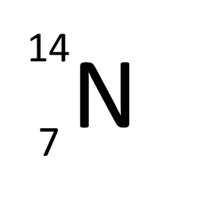
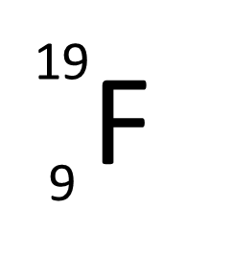
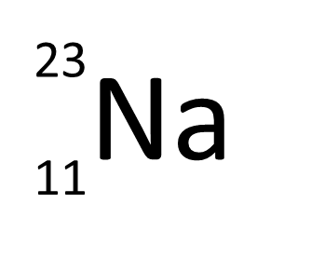
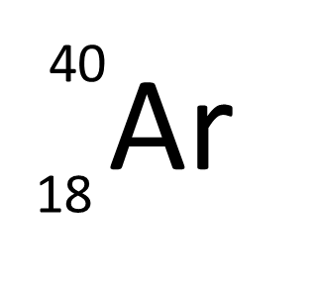
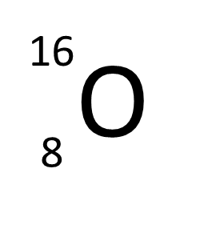

To start with…
Write the number of protons, neutrons and electrons found in each atom of these four elements.
27
Al
13
16
O
8
REMEMBER…
Mass Number
= number of protons plus neutrons
Atomic Number
= number of protons

Slide 4
The arrangement of electrons in atoms.
Learning Objectives:
Be able to draw electron shell diagrams and write electronic structure of atoms.
Be able to relate electron shell populations to reactivity and properties of groups.

Slide 5
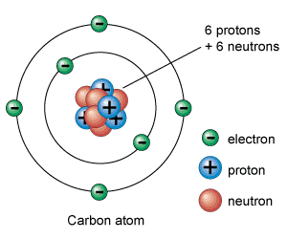
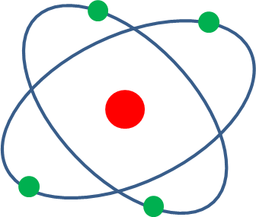
Electron Shells
Electrons orbit the nucleus in shells.
The shells are at different energy levels.
The closer they are to the nucleus the lower the energy level.
- The first shell has the lowest energy level.

Slide 6
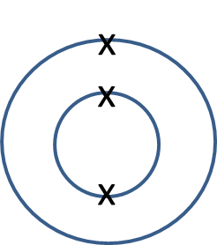
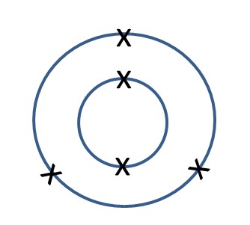
Electron Shell Diagrams
The first shell can only hold 2 electrons but each shell after that can hold 8.
xx
xx
x
Li
B
xx
xx
Ar
xx
xx
x
xx
xx
Lithium 2,1
Boron 2,3
Argon 2,8,8
It is the number of electrons in the outer shell (higher energy level) that tells you what group the element is in and determines their properties.

Slide 7
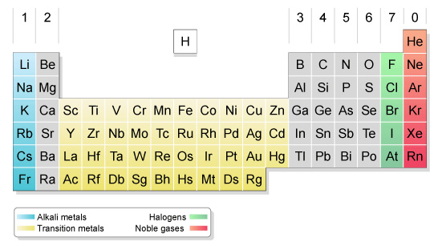
Groups – Elements in groups have the same number of electrons in the outer shell and so have similar properties.
You need to be able to draw electron shell diagrams and write electronic structures up to calcium, Ca.

Slide 8
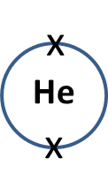
On your whiteboards.
Draw electron shell diagrams and write electronic structures for:
Helium
2

Slide 9
On your whiteboards.
Draw electrons shell diagrams and write electronic structures for:
Sodium
x
xx
x
xx
Na
xx
x
xx
2,8,1

Slide 10
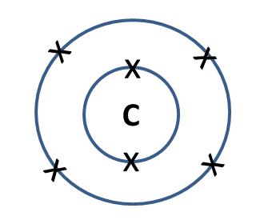
On your whiteboards.
Draw electron shell diagrams and write electronic structures for:
Carbon
2,4

Slide 11
On your whiteboards.
Draw electron shell diagrams and write electronic structures for:
Chlorine
x
xx
x
xx
xx
Cl
xx
xx
x
xx
xx
2,8,7

Slide 12
On your whiteboards.
Draw electron shell diagrams and write electronic structures for:
Aluminium
xx
x
x
xx
Al
xx
x
x
xx
x
2,8,3

Slide 13
On your whiteboards.
Draw electron shell diagrams and write electronic structures for:
Calcium
xx
xx
x
x
xx
xx
Ca
xx
xx
x
x
xx
xx
2,8,8,2

Slide 14

The arrangement of electrons in atoms.
Learning Objectives:
Be able to draw electron shell diagrams and write electronic structure of atoms.
Be able to relate electron shell populations to reactivity and properties of groups.

Slide 15
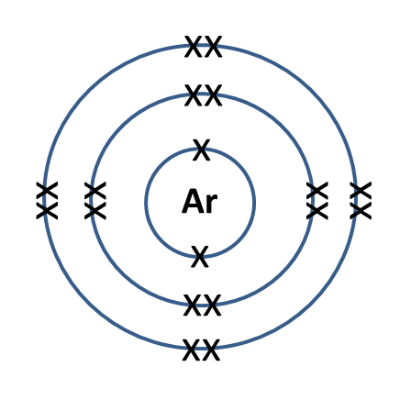
Explaining reactivity.
Atoms love to have a full outer shell of electrons – they will form ions in order to get this.
Calcium
Chlorine
Argon
xx
xx
xx
xx
x
x
x
xx
xx
Ca
xx
xx
x
xx
xx
Cl
xx
xx
x
x
xx
xx
x
xx
x
2,8,8,2
2,8,7
2,8,8
Ca²⁺ 2,8,8
Cl⁻ 2,8,8

Slide 16
Explaining reactivity.
Atoms love to have a full outer shell of electrons – they will form ions in order to get this.
Sodium
Oxygen
Neon
x
xx
xx
xx
x
x
x
xx
Na
xx
x
O
x
xx
Ne
xx
x
x
x
x
x
xx
xx
xx
2,8,1
2,6
2,8
Na⁺ 2,8
O²⁻ 2,8

Slide 17
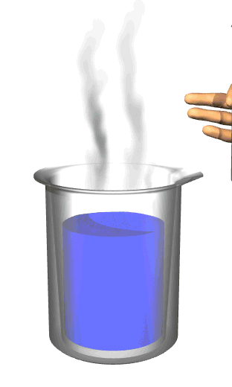
Reaction of Group 1 metals with Water
Record your observations of what you observe for each metal

Slide 18
Reaction with water
Sodium + Water Sodium Hydroxide + Hydrogen
_{Alkali}
2Na_{(s)} + 2H₂O_{(l)} 2NaOH_{(aq)} + H_{2(g)}
_{Alkali}
Potassium + Water Potassium Hydroxide + Hydrogen
_{Alkali}
2K_{(s)} + 2H₂O_{(l)} 2KOH_{(aq)} + H_{2(g)}
_{Alkali}

Slide 19

Group 1 metals.

Slide 20
Reaction with halogens
Sodium + Chlorine Sodium Chloride
2Na_{(s)} + Cl_{2(g)} 2NaCl_{(s)}
Potassium + Fluorine Potassium Fluoride
2K_{(s)} + F_{2(g)} 2KF_{(s)}

Slide 21
The arrangement of electrons in atoms.
Learning Objectives:
Be able to draw electron shell diagrams and write electronic configuration of atoms.
Be able to relate electron shell populations to reactivity and properties of groups.

Slide 22
The electrons in an atom are arranged around the …………. in ………….. (energy levels). The electrons further away from the nucleus have more ………….. than those close to the nucelus. All elements in the same …………. of the periodic table have the same number of ……………. in their outermost shell
Wordbank: electrons, energy, group, nucleus, shells.
Draw the arrangement of electrons in the following atoms and label each one with its electronic structure.
Li b) B c) P d) Ar
What is special about the electronic structure of neon and argon?

Slide 23
The electrons in an atom are arranged around the …………. in ………….. (energy levels). The electrons further away from the nucleus have more ………….. than those close to the nucelus. All elements in the same …………. of the periodic table have the same number of ……………. in their outermost shell
Wordbank: electrons, energy, group, nucleus, shells.
nucleus
shells
energy
group
electrons
Draw the arrangement of electrons in the following atoms and label each one with its electronic structure.
Li b) B c) P d) Ar
What is special about the electronic structure of neon and argon? – They have a full outer shell of electrons and so are very stable atoms.

Slide 24

Li
B
Lithium 2,1
Boron 2,3
x
x
x
x
x
x
x
x
P
x
Ar
x
x
x
x
x
x
Phosphorus 2,8,5
Argon 2,8,8

Slide 25
Homework
Use a periodic table to help you.
Argon is the 18th element in the periodic table.
Is Argon a metal or non-metal?
Are there more metals or non-metals in the periodic table?
How many protons does an argon atom contain?
State the name and number of the group to which argon belongs.
How many electrons does argon have in its highest energy level (outermost shell)?
b) The element barium (Ba) has 56 electrons.
How many protons are in the nucleus of each barium atom?
How many electrons does barium have in its outermost shell? How did you decide on your answer?
How many neutrons are in the nucleus of each barium atom?

Slide 26
Editable Electron shells

Slide 27
On your whiteboards.
Draw electrons shell diagrams and write electronic configurations for:
Helium
x
He
x
2

Slide 28
On your whiteboards.
Draw electrons shell diagrams and write electronic configurations for:
Sodium
x
x
x
x
x
x
Na
x
x
x
x
x
2,8,1

Slide 29
On your whiteboards.
Draw electrons shell diagrams and write electronic configurations for:
Carbon
x
x
x
C
x
x
x
2,4

Slide 30
On your whiteboards.
Draw electrons shell diagrams and write electronic configurations for:
Chlorine
x
x
x
x
x
x
x
x
x
Cl
x
x
x
x
x
x
x
x
2,8,7

Slide 31
On your whiteboards.
Draw electrons shell diagrams and write electronic configurations for:
Aluminium
x
x
x
x
x
x
x
Al
x
x
x
x
x
x
2,8,3

Slide 32
On your whiteboards.
Draw electrons shell diagrams and write electronic configurations for:
Calcium
x
x
x
x
x
x
x
x
x
x
Ca
x
x
x
x
x
x
x
x
x
x
2,8,8,2

Slide 33
Explaining reactivity.
Atoms love to have a full outer shell of electrons – they will form ions in order to get this.
Sodium
Chlorine
Argon
x
x
x
x
x
x
x
x
x
x
x
x
x
x
x
x
x
x
x
x
x
Ar
x
x
x
Na
x
x
x
Cl
x
x
x
x
x
x
x
x
x
x
x
x
x
x
x
x
x
x
x
x
2,8,1
2,8,7
2,8,8
Na⁺ 2,8
Cl⁻ 2,8,8

Slide 34
Electron Shell Diagrams
The first shell can only hold 2 electrons but each shell after that can hold 8.
x
x
x
x
x
x
x
x
x
x
x
Li
B
x
x
Ar
x
x
x
x
x
x
x
x
x
x
x
x
x
Lithium 2,1
Boron 2,3
Argon 2,8,8
It is the number of electrons in the outer shell (higher energy level) that tells you what group and determines their properties.

Slide 35
Explaining reactivity.
Atoms love to have a full outer shell of electrons – they will form ions in order to get this.
Sodium
Chlorine
Argon
x
xx
xx
xx
x
x
xx
Na
xx
xx
xx
Cl
xx
xx
x
x
xx
xx
x
x
2,8,1
2,8,7
2,8,8
Na⁺ 2,8
Cl⁻ 2,8,8

Slide 36
Explaining reactivity.
Atoms love to have a full outer shell of electrons – they will form ions in order to get this.
Calcium
Oxygen
Aluminium
xx
xx
xx
xx
x
x
x
x
xx
xx
Ca
xx
xx
x
x
x
x
xx
Al
xx
x
x
O
x
x
x
x
xx
xx
xx
xx
x
2,8,8,2
2,6
2,8,3
Ca²⁺ 2,8,8
O²⁻ 2,8
Al³⁺ 2,8

